Slide 1
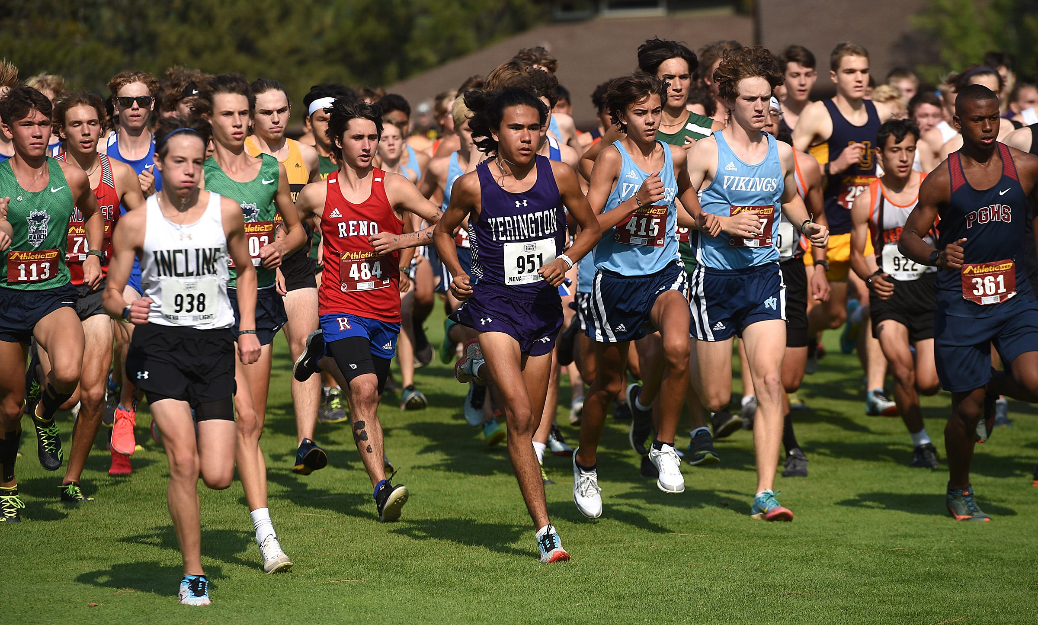
Validation of problem
Consumers, Users, and Interviews: Among high school cross-country runners it was indicated that 60% were unaware of their current running cadence, yet 75% of them expressed concern about past or potential injury. The consensus among users is that professional gait analysis is too expensive and hard to access to be a practical training tool.
Scholarly Articles: Research published in the Journal of Orthopaedic & Sports Physical Therapy confirms that increasing a runner's cadence by 5-10% can significantly reduce loading rates at the knee and hip, validating the need for simple cadence feedback.
Brief Summary of Existing Products and Patents: High-end competitive products offer power metrics but are priced at over $200, confirming the existence of a high-price barrier. Existing patents primarily focus on complex multi-sensor systems, which drives up manufacturing cost.

Slide 2
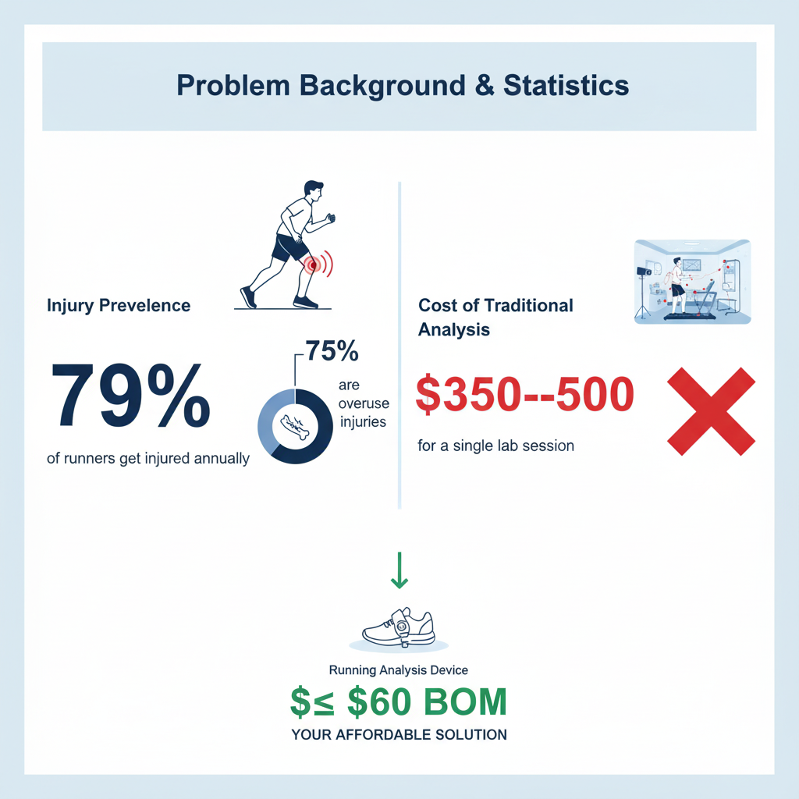
Statistics:
Injury Prevalence (Why the Problem Exists)
79%, The estimated amount of runners who sustained an injury that interferes with running activity during any given year.
50-70%, The range of running injuries that are overuse injuries, which are directly linked to repetitive stress from poor biomechanics.
20 to 40 times, The magnitude of increase in the average runner's injury risk when transitioning from low to high mileage without correcting underlying form flaws.
Biomechanics and Impact (Why the Solution Works)
170-180 steps per minute, The widely accepted "optimal" cadence range for reducing impact forces.
5-10%, The required increase in a runner's cadence shown to significantly reduce stress on the hip, knee, and ankle joints. Your device provides the data needed for this precise adjustment.
2.5-3.5 times body weight, The typical peak vertical ground reaction force experienced during running. Monitoring and reducing force is the best way to prevent bone stress injuries.
Cost & Accessibility (Why Our Project is Necessary)
$350 to $500, The average cost for a single, professional in-lab gait analysis session.
<$60, Our project's estimated bill of materials cost.
4 to 8 weeks, The typical length of time a runner may need physical therapy for a moderate overuse injury.

Slide 3

Gathering info
We found our information primarily from online research on various topics within our project. Information we gathered from this research included analyzing both developed commercial products and patented technologies that address gait analysis. One of the main things we were looking at was the cost versus data trade off in existing products that work.
ThePhoto by PhotoAuthor is licensed under CCYYSA.
ThePhoto by PhotoAuthor is licensed under CCYYSA.

Slide 4
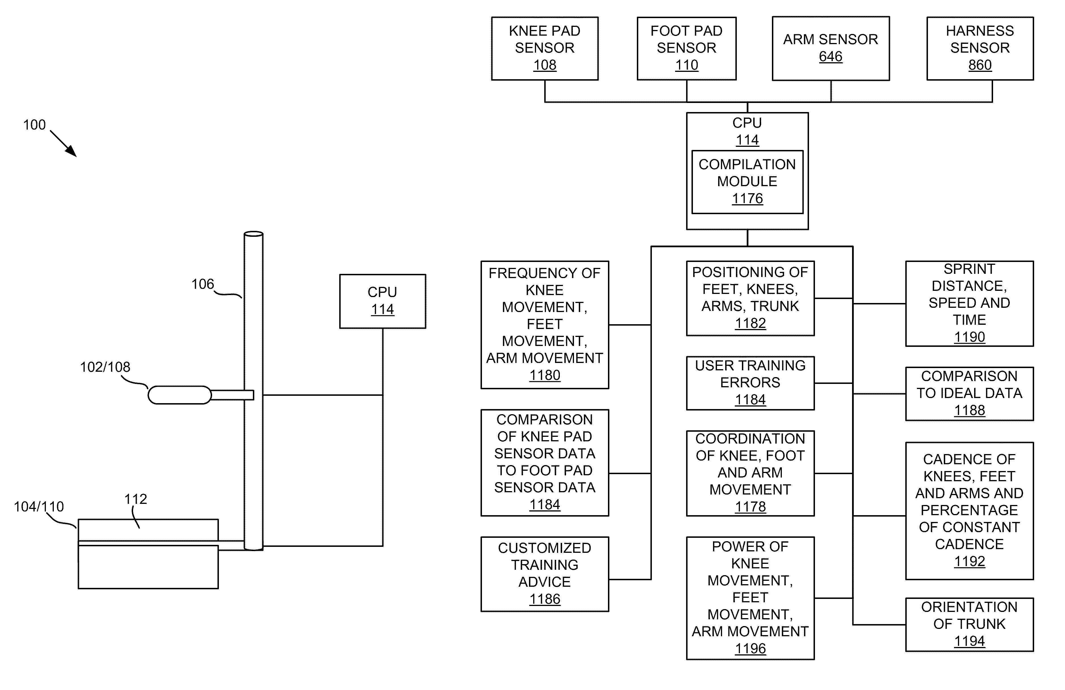
Similar patents

Slide 5
Similar Patents
Abstract
An apparatus, system, and method are disclosed for accurate measurement, compilation, and presentation of sprinting and running technique data. In one embodiment, the apparatus, system and method includes a knee pad configured to contain a knee pad sensor, a foot pad configured to contain a foot pad sensor and a main trunk that connects the foot pad and the kneepad. The knee pad sensor and the foot pad sensor sense movement near the sensors and contact to the sensors. Data from the sensors is output to a CPU. In one embodiment, the apparatus, system and method include arm sensors. The arm sensors sense arm movement of a user and report arm movement data to the CPU. In a further embodiment, the apparatus may be configured to contain a harness positioned opposite the main trunk.
Date of patent
03/08/2011
Patent number
US7901325B2
Pros
Provides detailed feedback
Pinpoints mistakes
Cons
Clunky
If the sensors move at all then data become inaccurate
Notes:
Summary
This devices goal was to track a persons movement during running or sprinting and return collected data to the user to help them improve.
The device would've done this by returning data collected from sensors in pads that go on the knee and foot and sending that data to a computer to process it and return it to the user

Slide 6
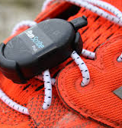
Similar devices
RunScribe
2 small compact devices that attaches to the laces of your shoes and tracks cadence and stride length and sends that data to an app that they have so that the user can see the data.
Price
600$
Pros
Small and compact
Measures and returns a bunch of different data
Cons
Expensive
Is out of business

Slide 7
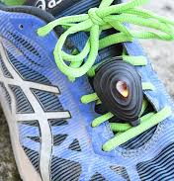
Similar devices
Stryd
A compact device that goes on the laces of your shoes and like RunScribe tracks cadence and stride length and sends that data to an app of theirs so that users can see the data
Price
200$ for their best version (stryd 5.0)
Pros
Instantaneous feedback
Highly accurate
Cons
Expensive
Uses a measurement system called power which isnt well known and requires a learning curve

Slide 8
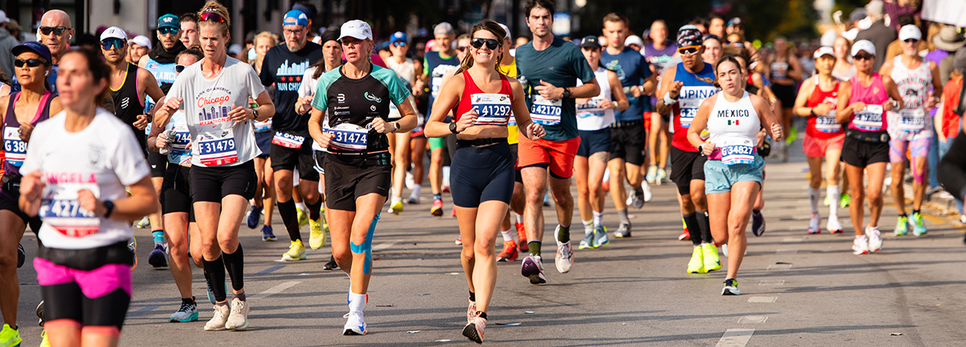
Primary Stake Holder
Input on Design Requirements
Users/Buyers Input: We have estimated that cost tolerance would likely be under $75, and the device must be small enough not to interfere with stride or balance.
Manufacturers Input: Component selection was limited to common, off-the-shelf microcontrollers and sensors (Arduino Nano, MPU-6050) to ensure low BOM and ease of assembly.
Users: Recreational runners and high school athletes
Buyers: Parents, coaches, or school athletic departments.
Sellers: E-commerce platforms and/or sporting goods stores.
Manufacturers: Electronics assemblers.

Slide 9
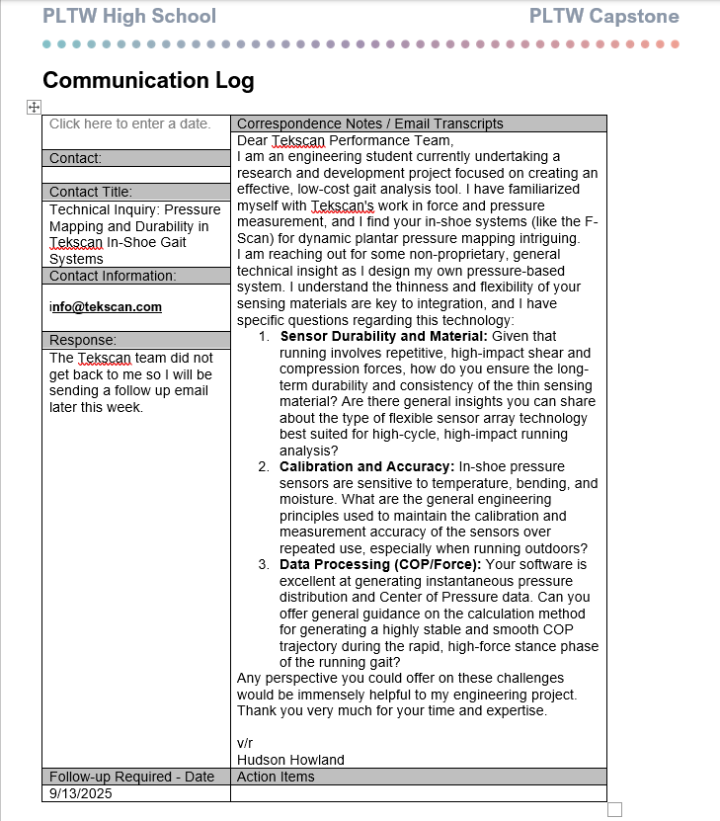
Communication Log
I reached out to Tekscan because I like their concept with the shoe insert and the ankle mount.
Did not receive an email back from their team
Planning on sending a follow up email next week.

Slide 10
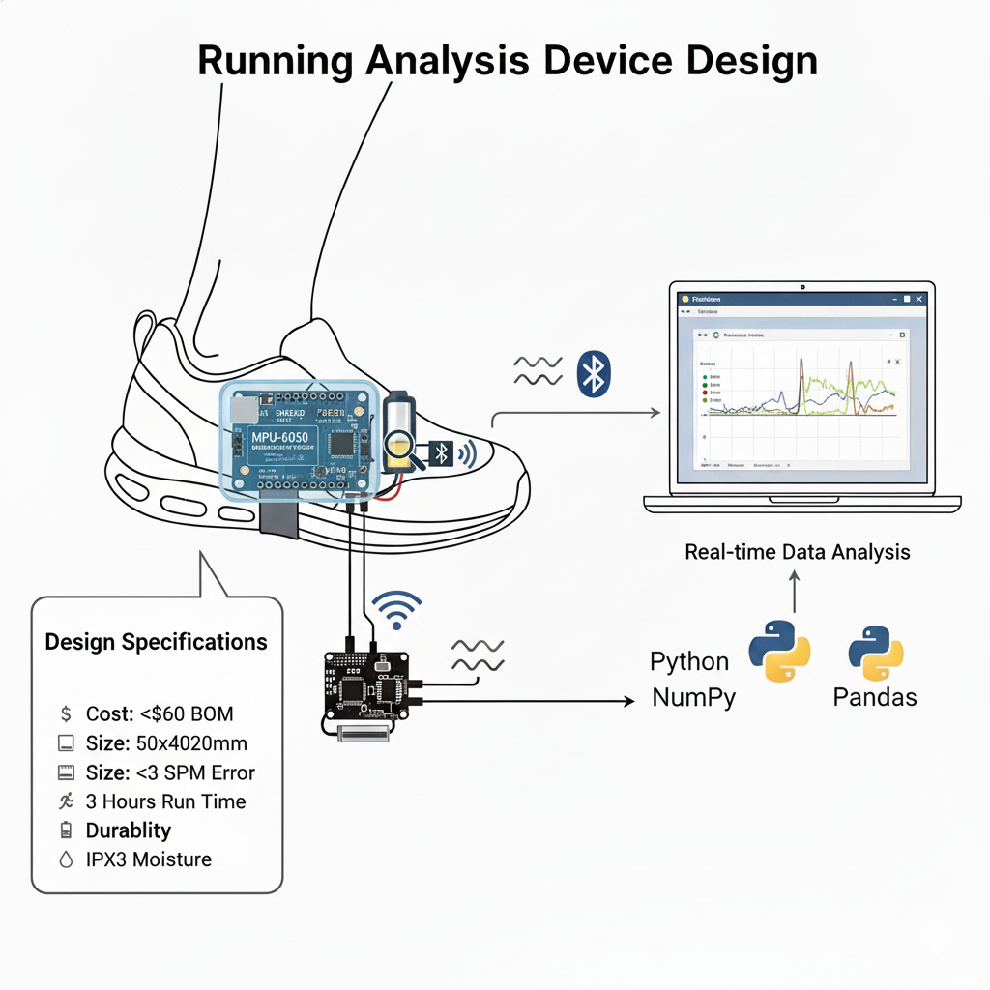
Determination of Design Specifications
Our design specifications have been determined by balancing user focused needs with technical feasibility and cost constraints. The core objective is to achieve high accuracy for high-impact events without the high cost associated with lab equipment. Input from target users and technical research guides our prioritization of functional requirements over non-essential features, ensuring a minimum viable product that solves the core problem.

Slide 11
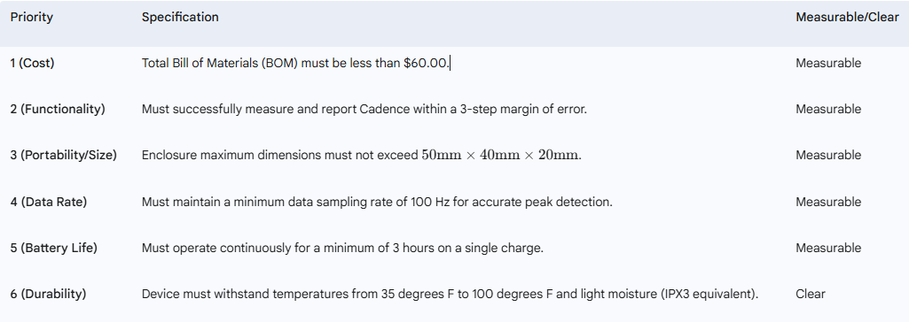
Design Specifications

Slide 12
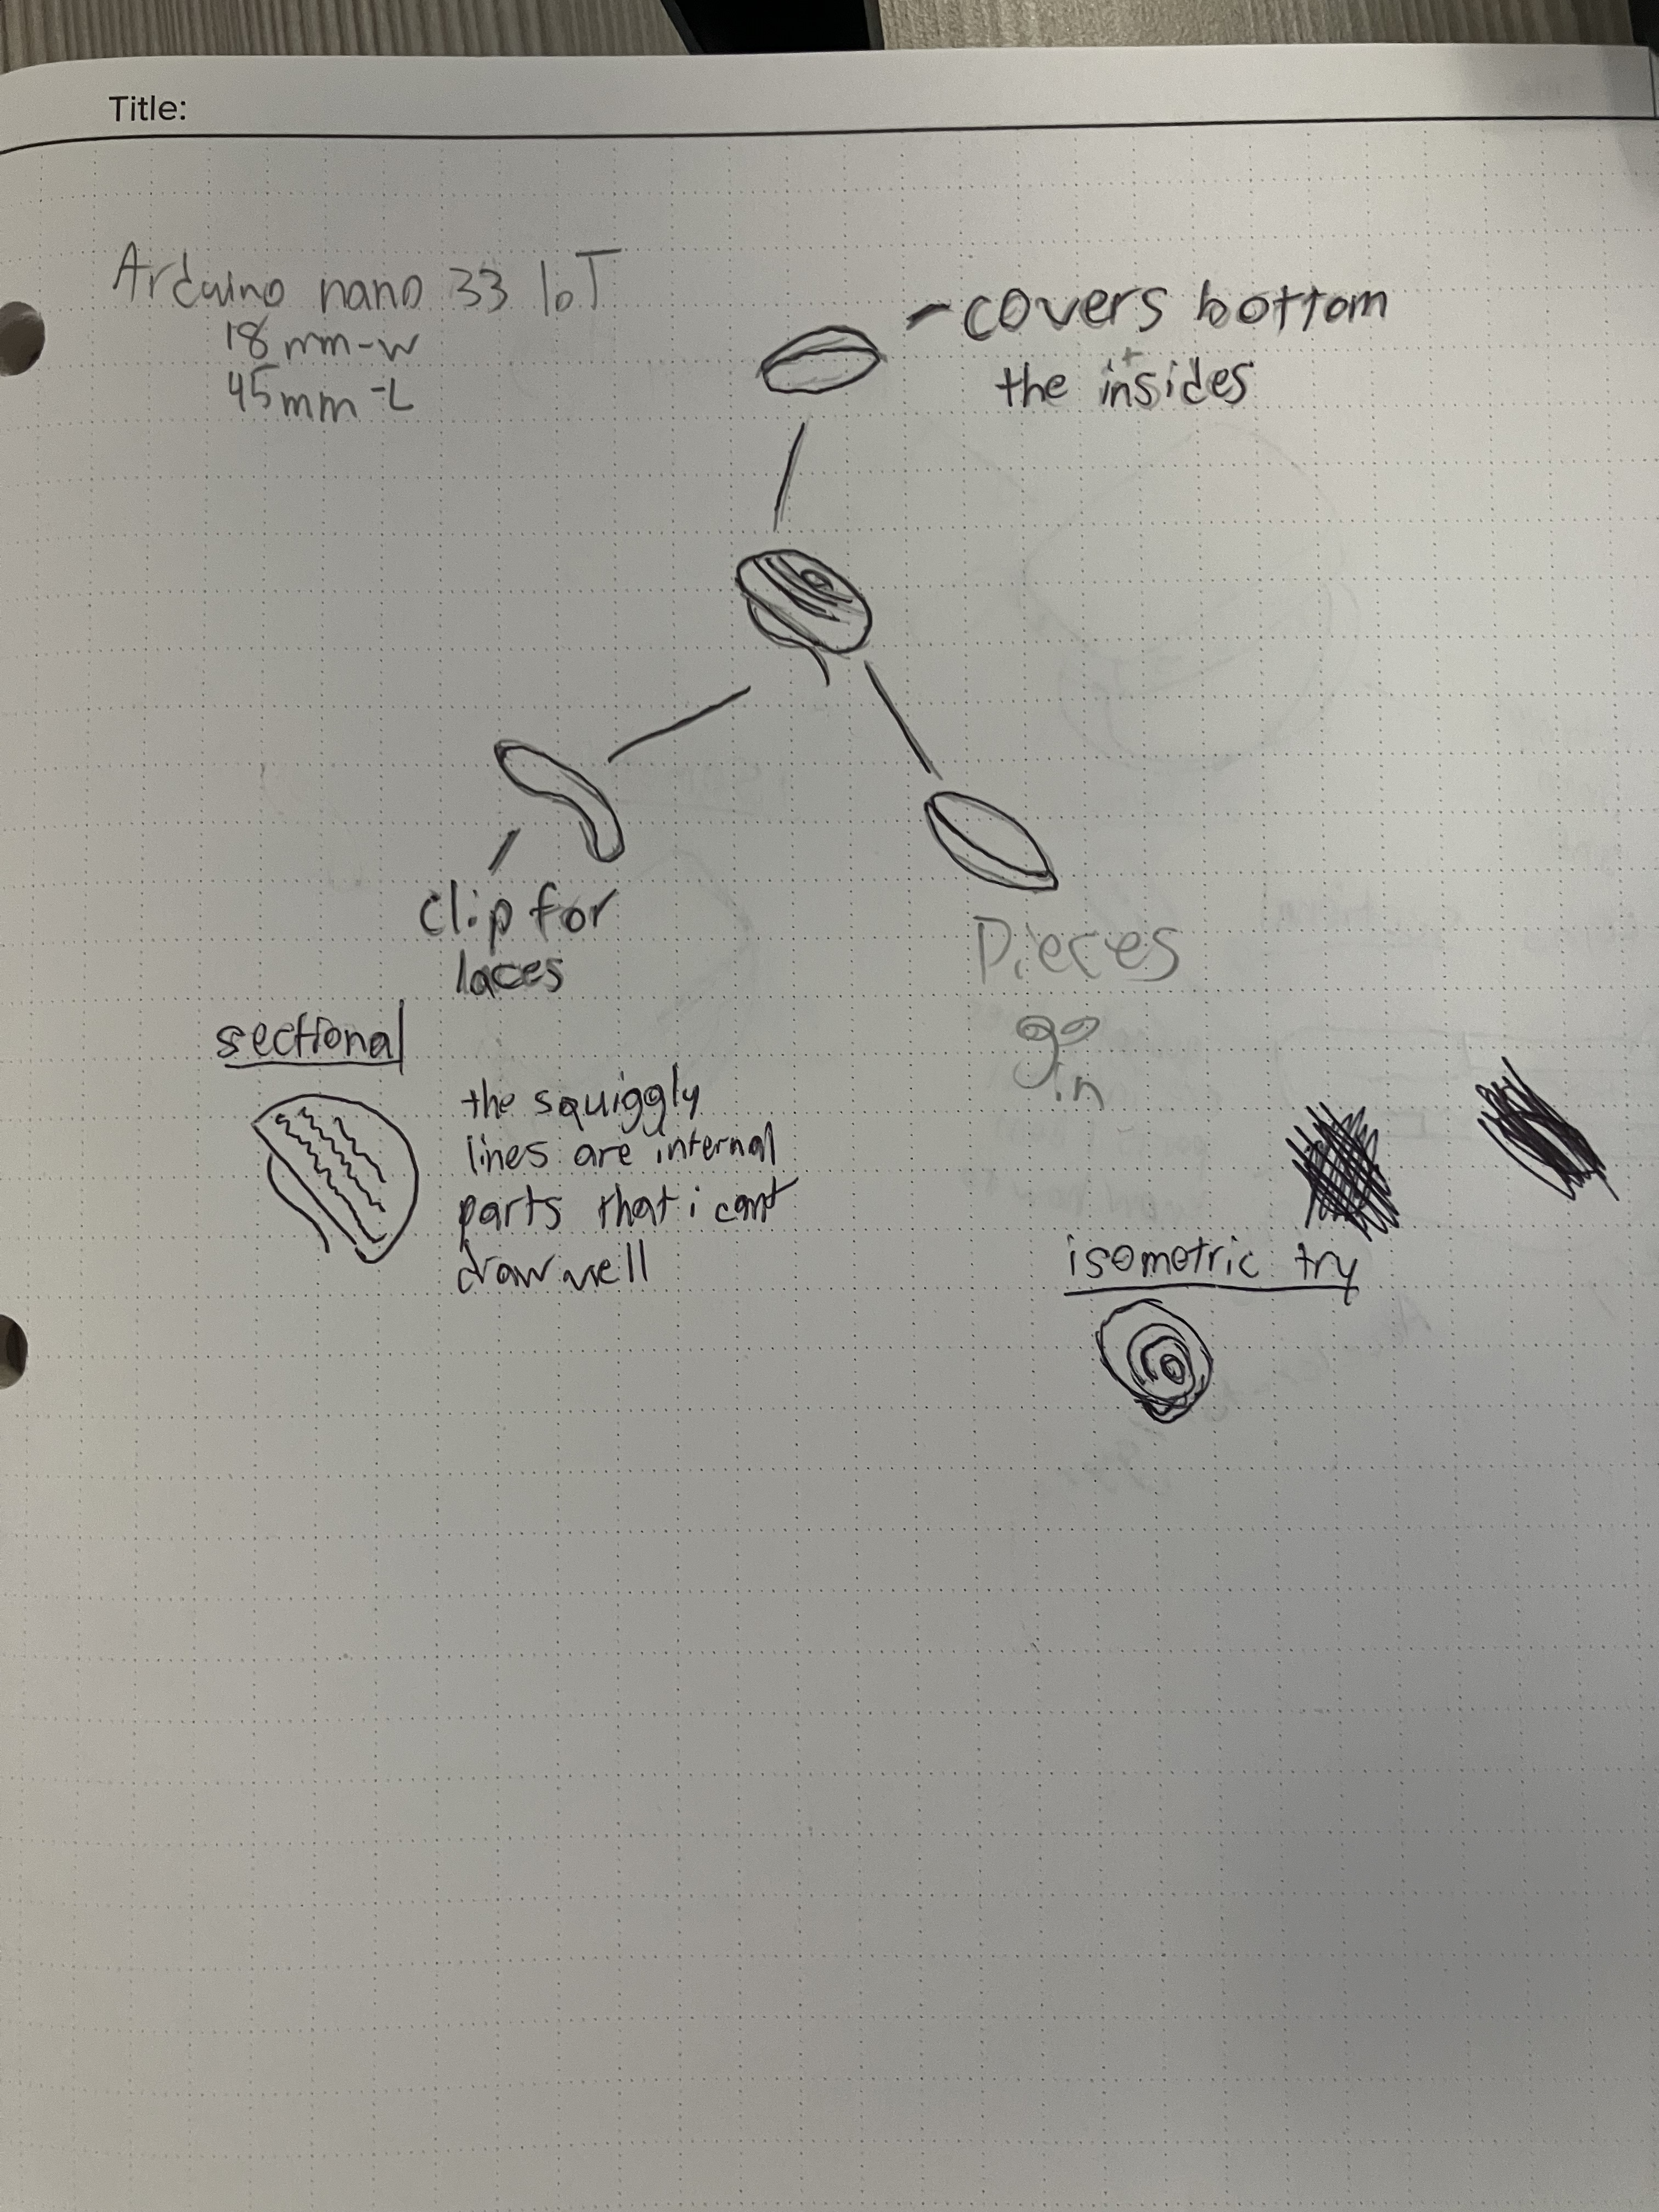
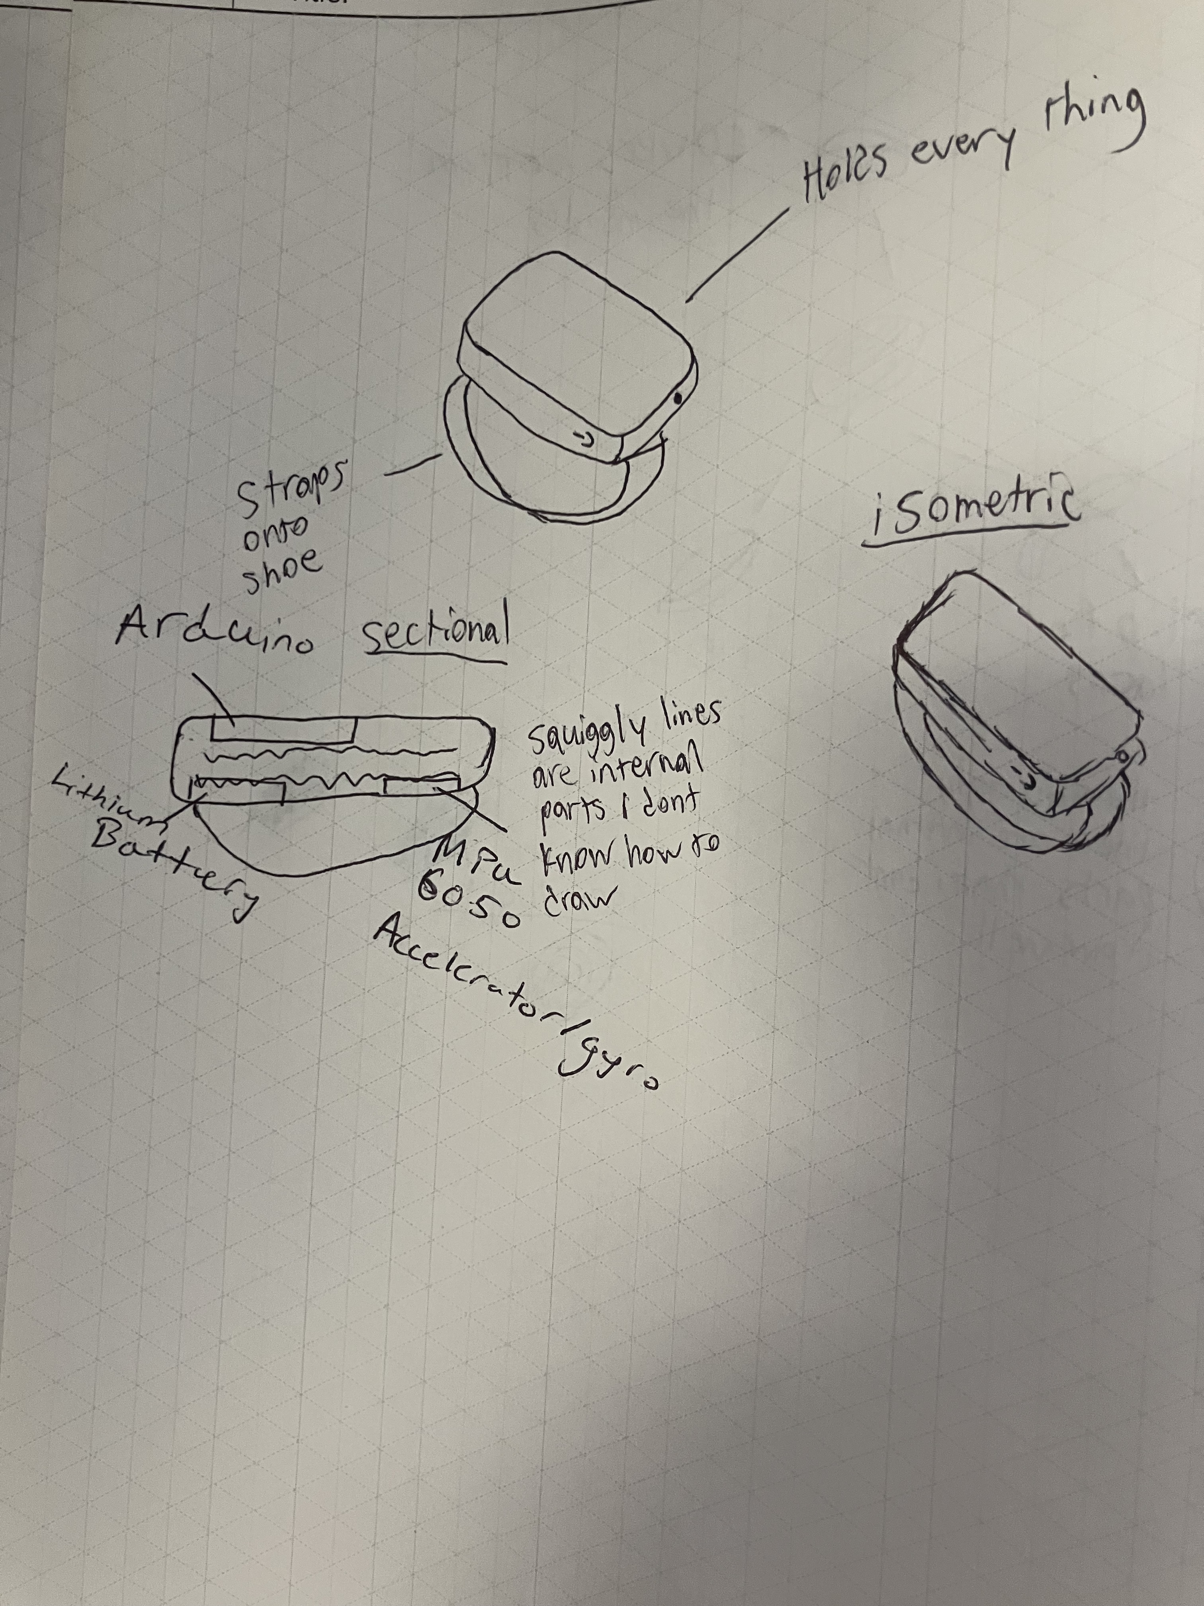
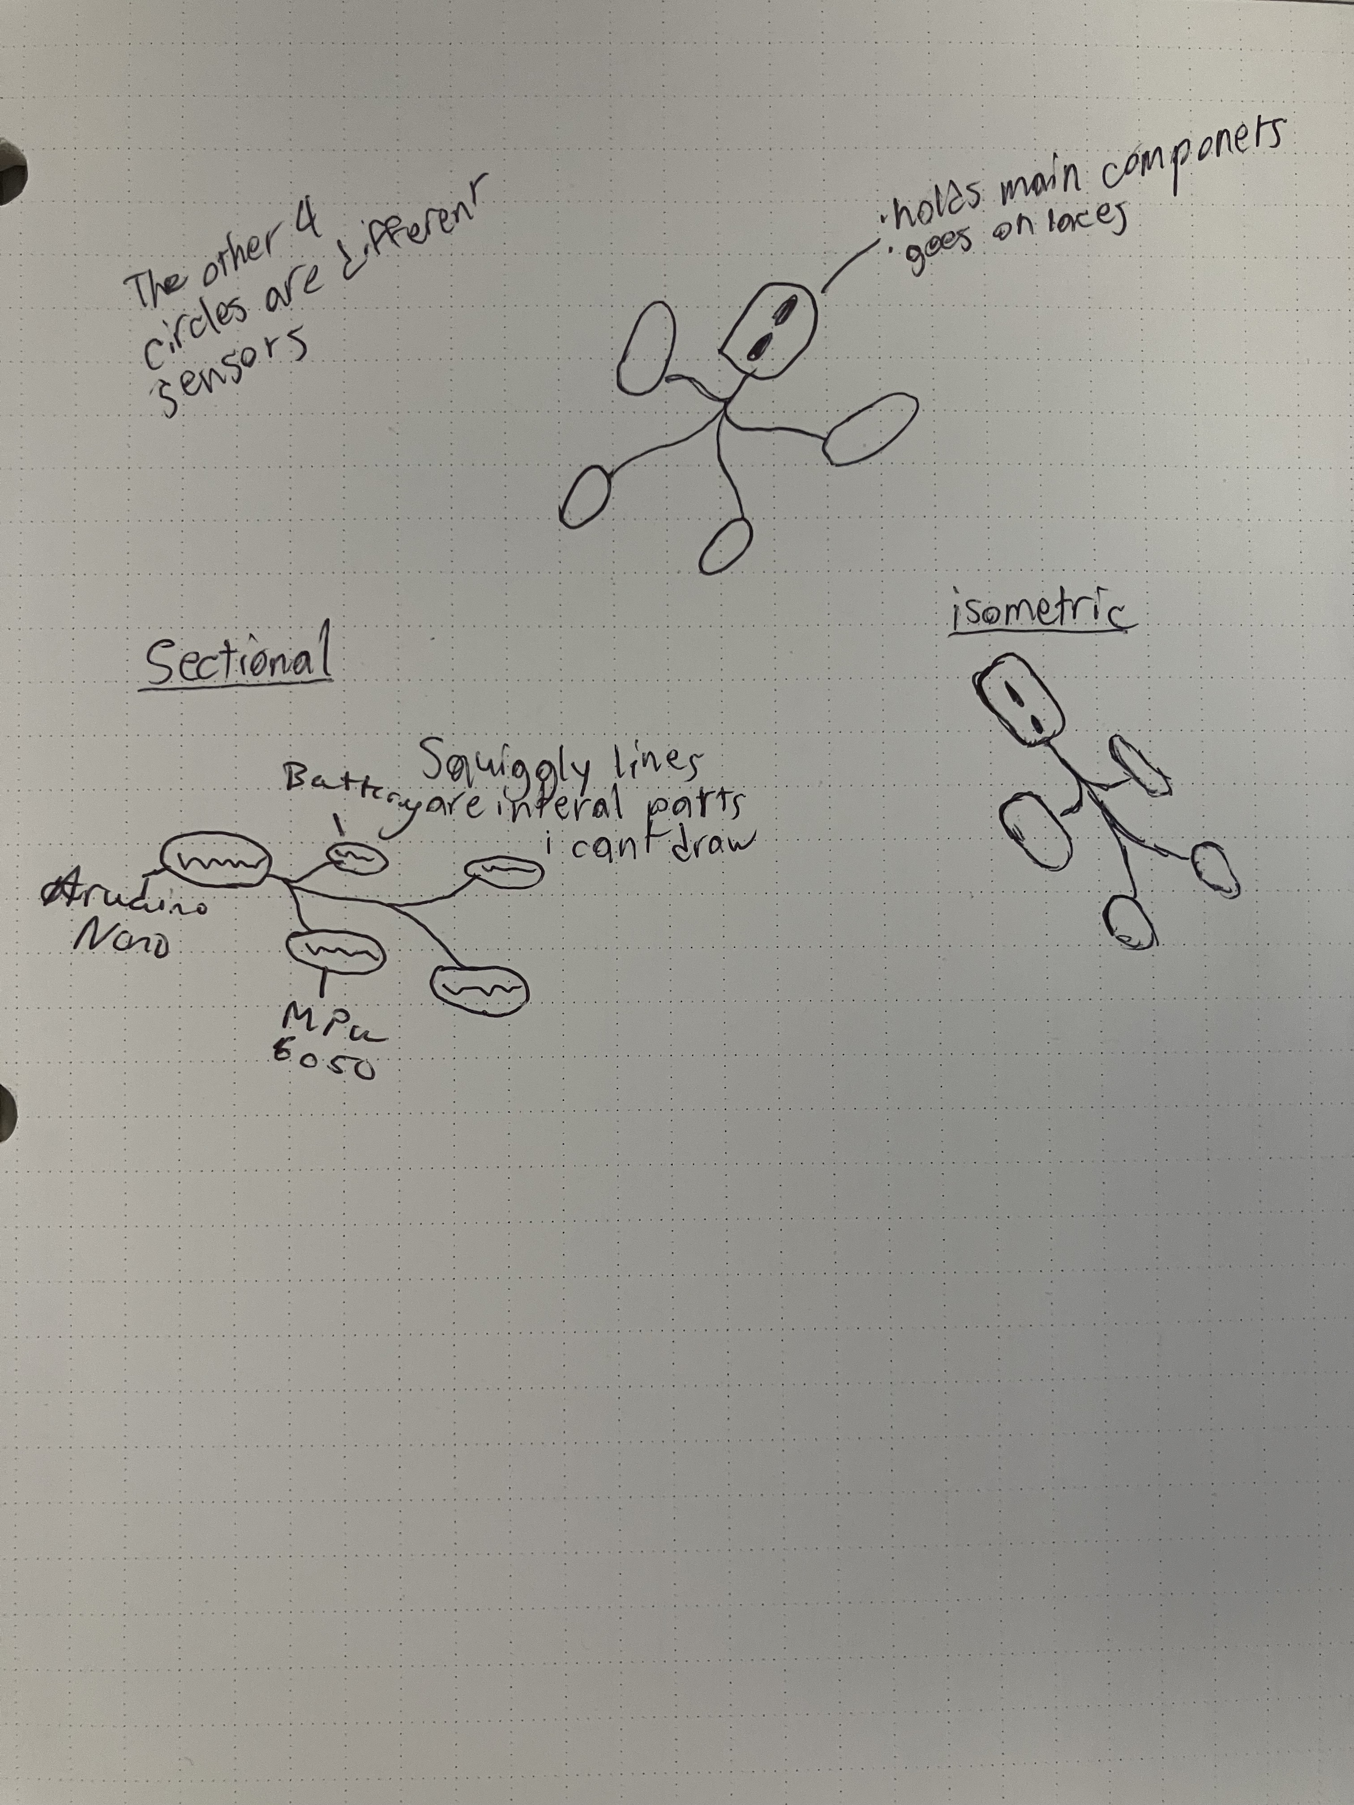
Design concepts
Concept 1
Concept 2
Concept 3

Slide 13
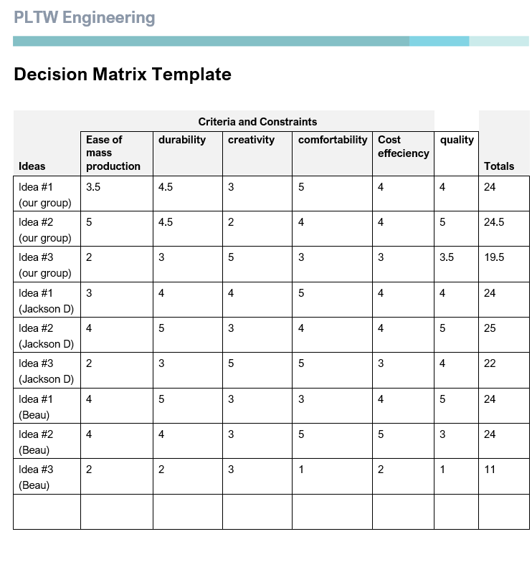
Decision matrix

Slide 14
Design concepts: Final Design
Concept 2
This design had the best total score out of each design we tested with the design matrix.
Although this design is not the most creative, we determined that it is the best option because it is simple, cost effective, and durable.

Slide 15
Final decision

Slide 16
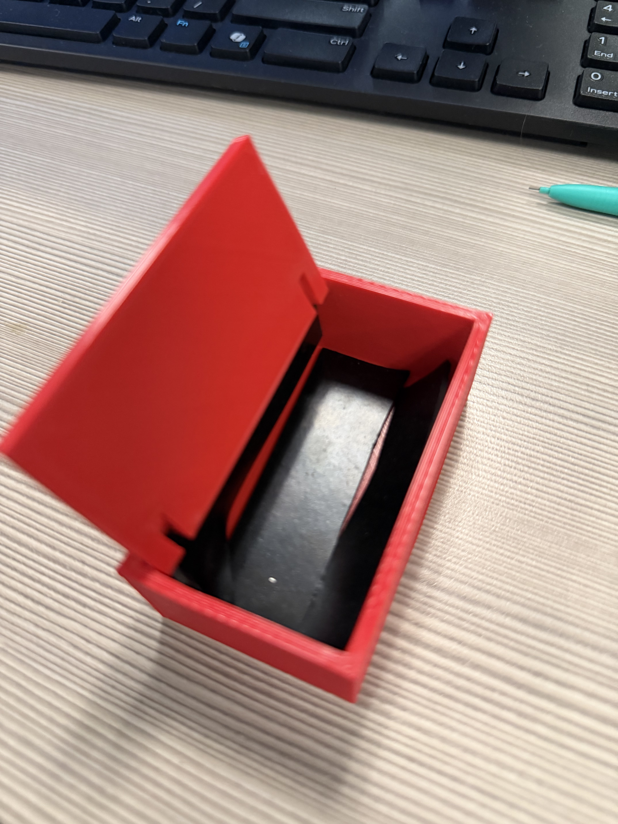
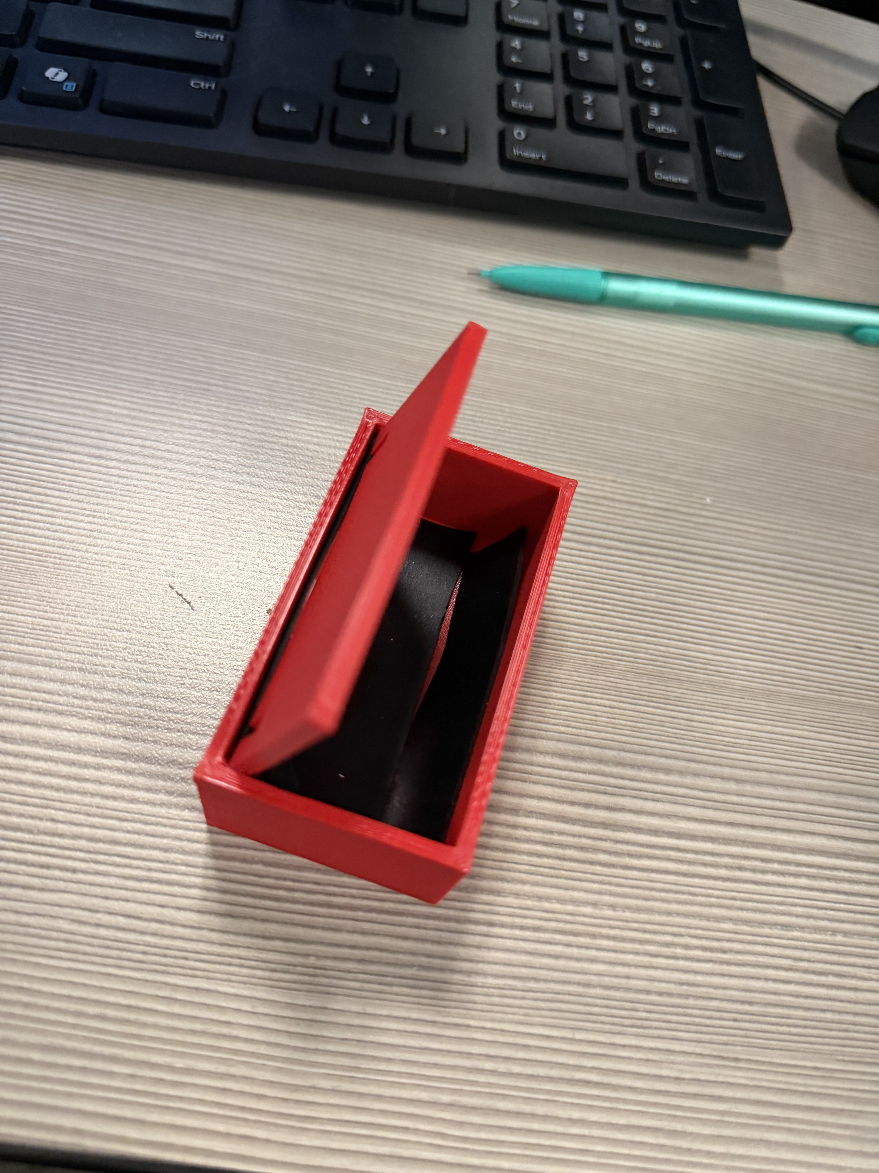
Final Prototype
Design Features
Snap-Fit Assembly: The box is designed with a two-part construction for easy access to the battery and internal components during the testing phase.
Integrated Mounting Points: The exterior geometry includes specialized slots to accommodate the elastic strap system, ensuring the sensor remains aligned with the foot's longitudinal axis.
Internal Layout: The internal volume is optimized to prevent component shifting, which is critical for maintaining data integrity during high-speed movement.
Manufacturing & Materials
Chassis Material: PLA Filament. We used inventor modeling and 3D printing to create the main enclosure. PLA was selected for its high strength-to-weight ratio and ease of rapid prototyping, ensuring the device meets our Priority constraints.
Shock Absorption: High-Density Rubber Dampening. To mitigate the high G-forces of running impacts, the internal cavity features rubber inserts. These act as a mechanical low-pass filter, protecting the sensitive MPU-6050 sensor and Arduino from high-frequency vibrations and structural shock.

Slide 17
References:
Kakouris, N., Yener, N., & Fong, D. T. P. (2021, September). A systematic review of running-related musculoskeletal injuries in Runners. Journal of sport and health science. https://pmc.ncbi.nlm.nih.gov/articles/PMC8500811/#:~:text=About%2070%25%E2%80%9380%25%20of%20running%20disorders%20are%20due,stress%20syndrome%20is%20the%20most%20common%20RRMI.
Are you risking injury by going too far in your long run? here’s what new research says. (n.d.). https://www.runnersworld.com/health-injuries/a65792883/rethink-mileage-increase-running-injuries/
Mason, R., Pearson, L. T., Barry, G., Young, F., Lennon, O., Godfrey, A., & Stuart, S. (2023, January). Wearables for running gait analysis: A systematic review. Sports medicine (Auckland, N.Z.). https://pmc.ncbi.nlm.nih.gov/articles/PMC9807497/
Mason, R., Godfrey, A., Barry, G., & Stuart, S. (n.d.). Wearables for running Gait Analysis: A study protocol. PLOS ONE. https://journals.plos.org/plosone/article?id=10.1371%2Fjournal.pone.0291289
Wearable IMU - gait analysis. RunScribe. (2019, June 9). https://runscribe.com/
Stryd: Run with power. Stryd (United States). (n.d.). https://www.stryd.com/us/en
Henderson, J. (2011, March 3). Athletic training device.
Mason, R., Pearson, L. T., Barry, G., Young, F., Lennon, O., Godfrey, A., & Stuart, S. (2022, October 15). Wearables for running gait analysis: A systematic review - sports medicine. SpringerLink. https://link.springer.com/article/10.1007/s40279-022-01760-6

